Slide 1
Cyber Security
Technologies
01c ForSec Lab & RADISH
Davis & Broda
ITMS X4802 – Fall 2014

Slide 2
What is RADISH
RADISH is our virtual desktop infrastructure to access:
  Windows 8.1 Virtual Machine (VM)
  Kali Linux VM via VNC from Windows 8.1 VM
  Your physical desktop OS (Windows 8.1)
  Possibly your team project

Slide 3
VMware View Client on Lab PCs
Your ForSec Lab computer is already preinstalled with VMware View Client
Click on Start > Type View (this will start a search)> Run the VMware Horizon View Client by clicking on the VMware Horizon View Client icon located on the right side of the start window
I suggest placing a shortcut of the Client on your desktop
VMware View is the mechanism by which you will access RADISH on which your VMs are running

Slide 4
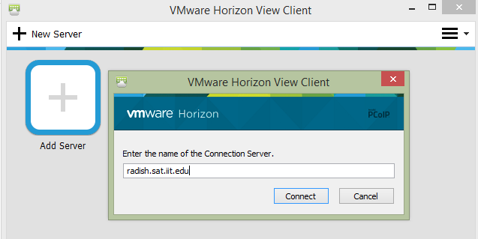
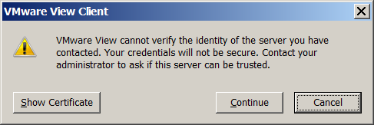
Connecting to RADISH Using VMware View
Start the VMware View Client
Set the connection server
address to radish.sat.iit.edu
Click on Connect
This screen might pop-up
Click on Continue
Note: Your VMware Horizon View Client will look a little different than
these slides

Slide 5
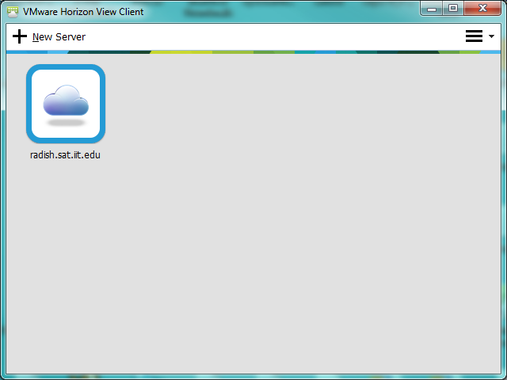
VMware View Client Usage
Double-click on
the Radish server icon

Slide 6
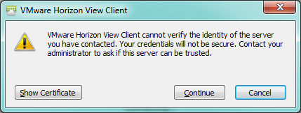
VMware View Client Usage

Slide 7
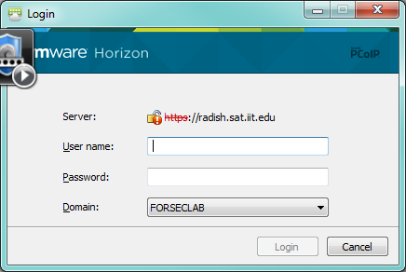
VMware View Client Usage
Enter your Username and Password provided by Dawid:

Slide 8
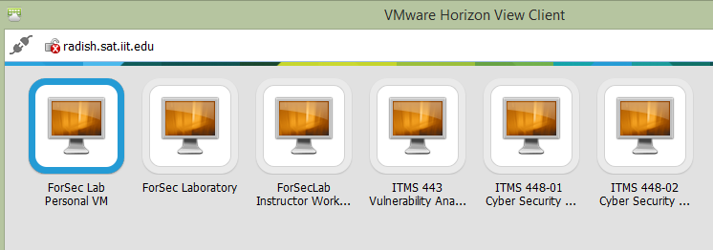
VMware View Client Usage
Make your machine choice: ITMS 448-02 Cyber Security Technologies
In a few seconds you will get your Win8.1 virtual machine desktop

Slide 9
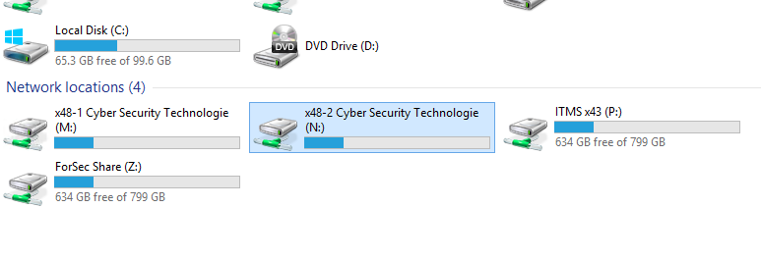
Forsec Share (N: Drive)

Slide 10
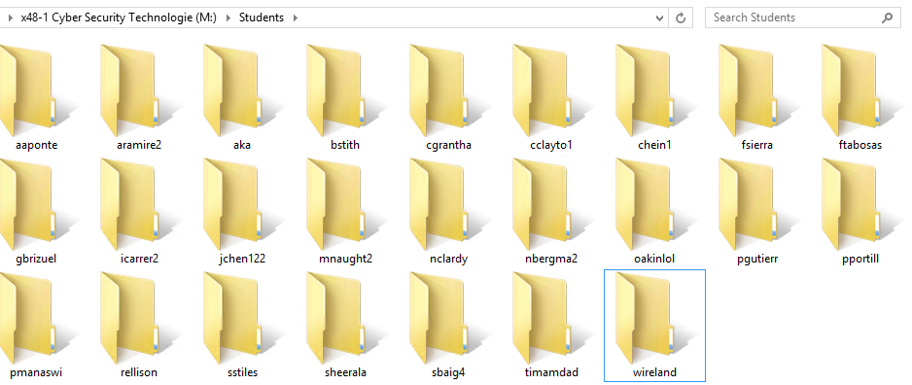
Forsec Share (N: Drive)
Personal Folder
  Every Student has his/her own personal folder, which can be used to store any class related work
  Note: Only the owner and the class instructor can access personal folders

Slide 11
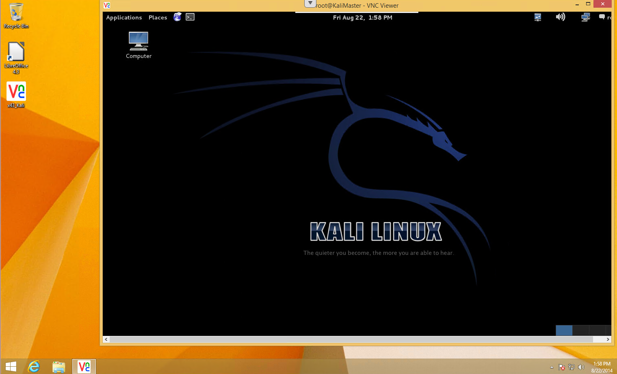
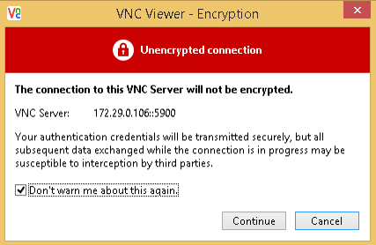
Kali Linux Access
May be used for Labs and Homework
To access: on your Win8.1 VM, open the Kali shortcut located on your desktop
The window below will pop-up; read it and Continue

Slide 12
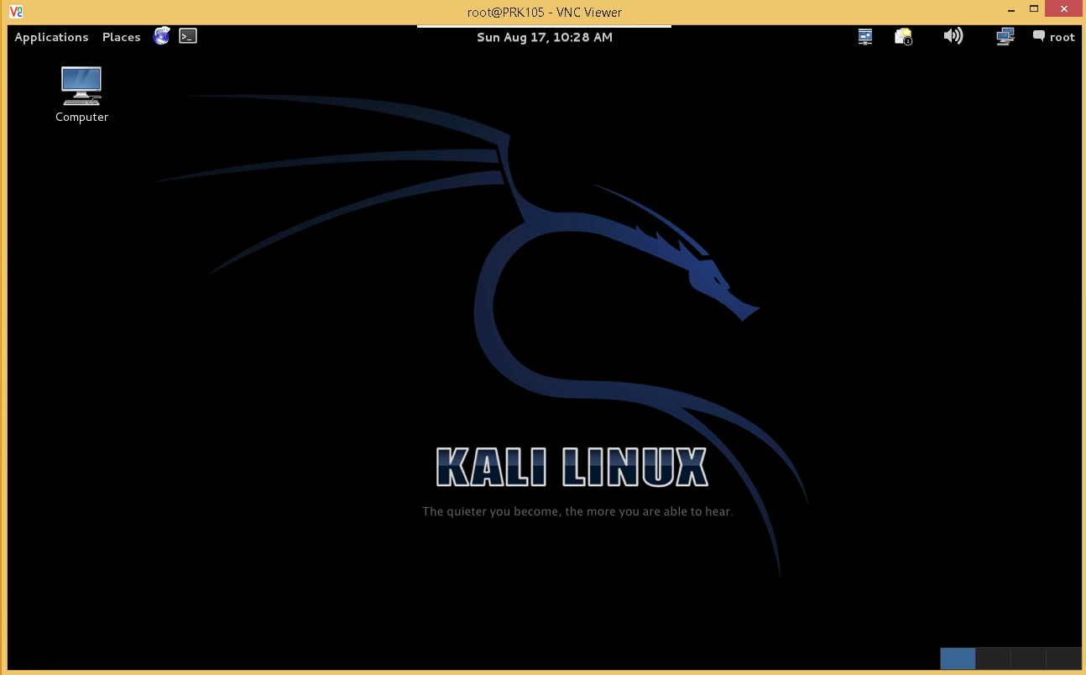
Kali Linux VM

Slide 13
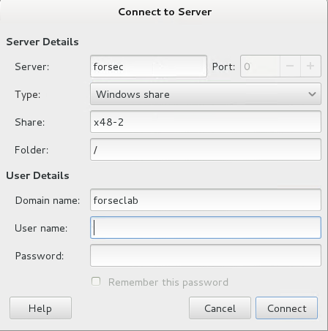
Kali Linux VM access to “N: Drive”
Click on Places and select Connect to Server… then fill out the window using your RADISH credentials

Slide 14
Student Projects
ForSec Labolatory is supported by Dawid Broda and Yalinne Castelan. Contact them at any time if you have any questions regarding RADISH or project equipment:
  Dawid Broda
  Contact Information: dbroda@hawk.iit.edu
  Yalinne Castelan
  Contact Information: ycastela@hawk.iit.edu

Slide 15
Accessing Your Student VMs from your Personal Computer and From Home
You must have good Internet connectivity from wherever you try to access RADISH
  I have Comcast as my ISP, and it works very well
  Connectivity from within IIT works even better
Poor Internet connectivity will make it difficult for you to work on your assignments from home

Slide 16
Ports That Must Be Open
VMware View uses https on port 443 to set up the connection
RDP uses port 3389
PCoIP uses port 4172 in our configuration
If anything is blocking these ports, you will not be able to access RADISH or your VMs
Usually these ports are open or TCP ports will be opened for TCP connections initiated by you

Slide 17
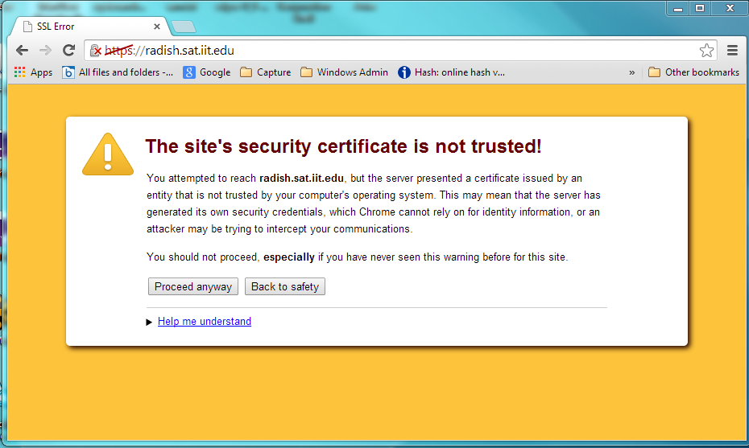
VMware View Client Installation
Navigate to: https://radish.sat.iit.edu
You may get a warning. Click Proceed anyway

Slide 18
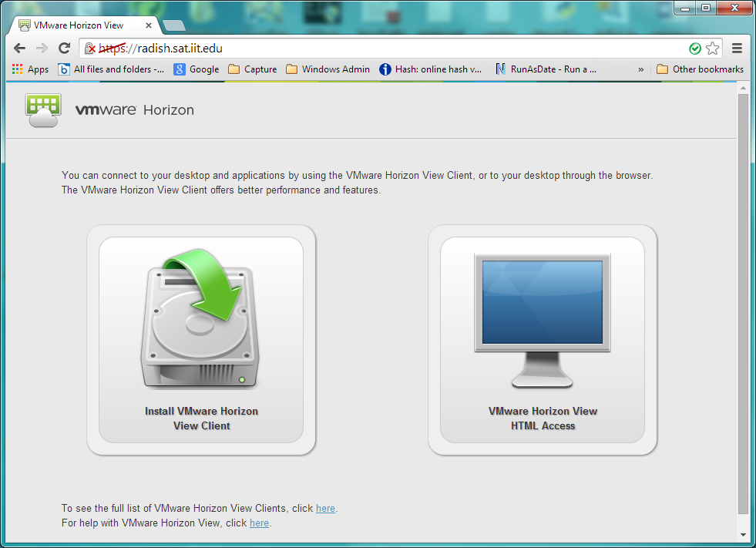
VMware View Client Installation
Choose the Horizon View Client list

Slide 19
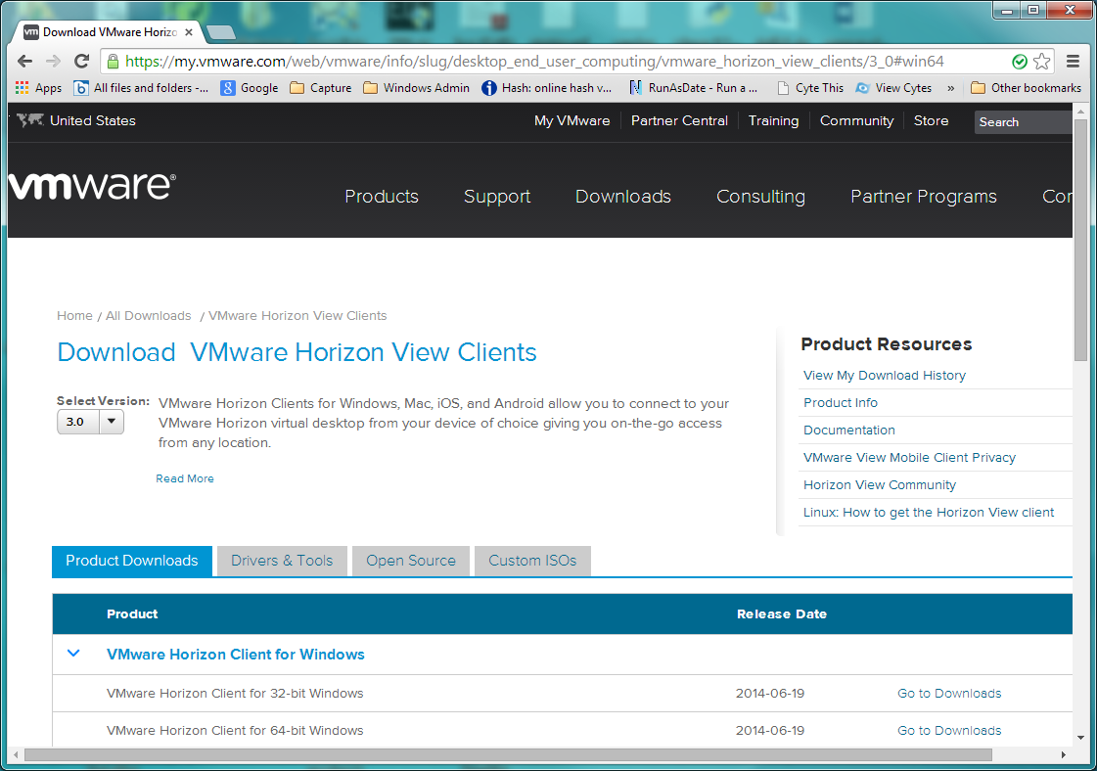
VMware View Client Installation
Select 32 bit or 64 bit based on your computer’s operating system.
You may also select Mac option if applicable.

Slide 20
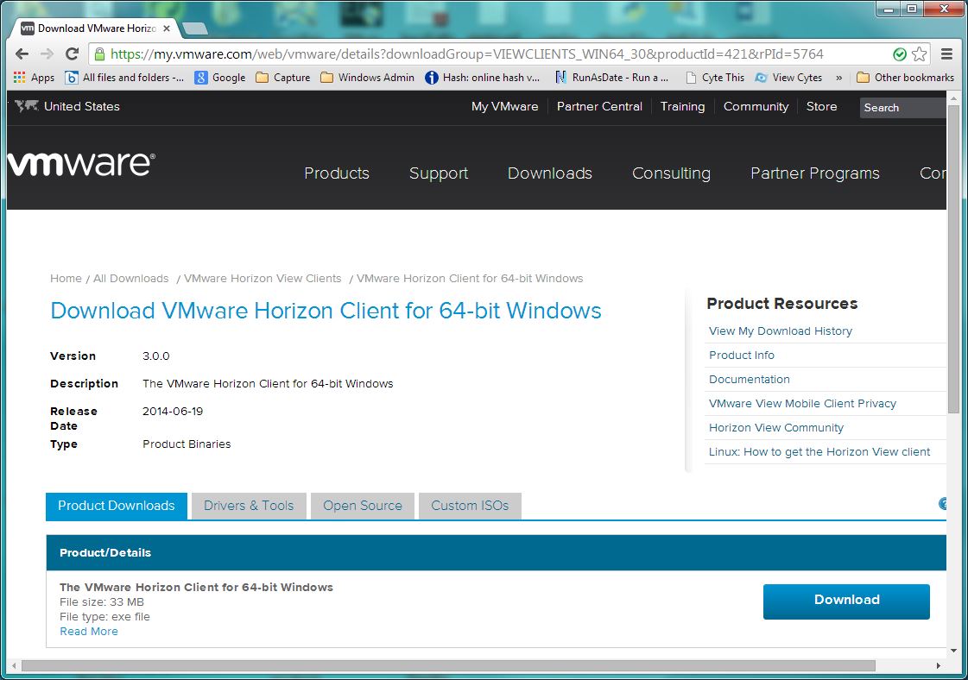
VMware View Client Installation

Slide 21
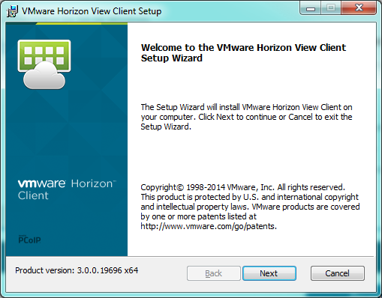
VMware View Client Installation
Run Installer Executable that was downloaded

Slide 22
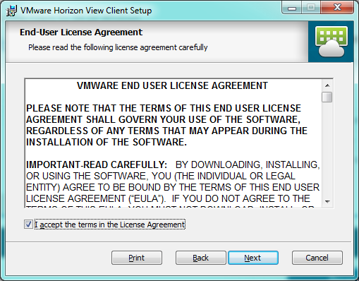
VMware View Client Installation

Slide 23
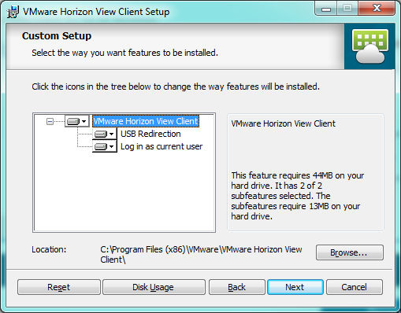
VMware View Client Installation

Slide 24
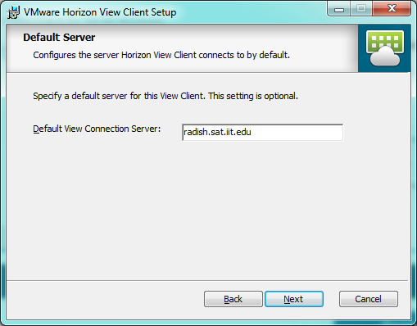
VMware View Client Installation

Slide 25
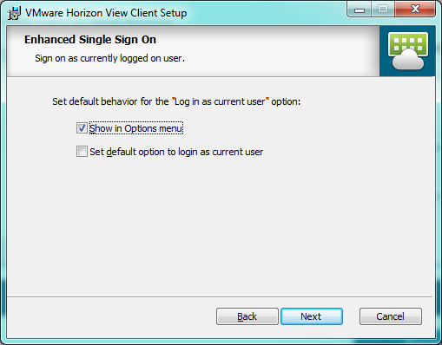
VMware View Client Installation

Slide 26
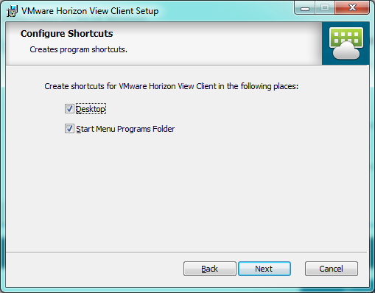
VMware View Client Installation

Slide 27
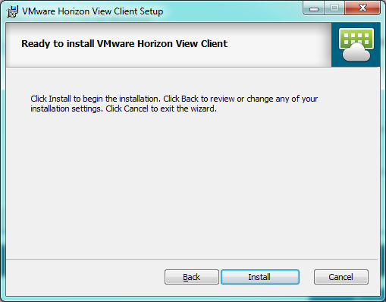
VMware View Client Installation

Slide 28
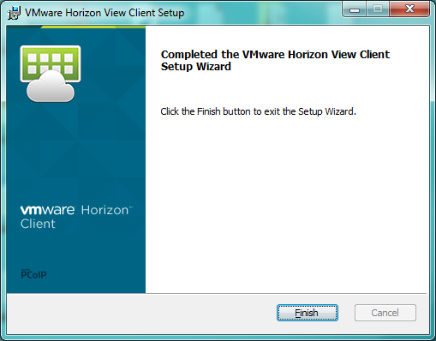
VMware View Client Installation

Slide 29
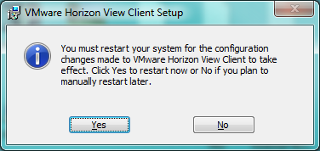
VMware View Client Installation

Slide 30
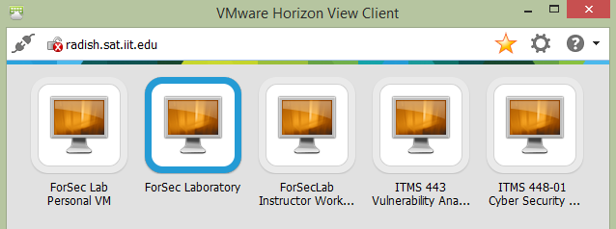
Access to Lab Physical Computers
You can access ForSecLab class workstation by choosing ForSec Laboratory

Slide 31
Lab Physical Computers Limitation
Only 20 concurrent users are allowed to work remotely on ForSec Laboratory computers
  You will be notified if the limit is reached
Access to the ForSec Laboratory will be unavailable when classes take place. Access will be suspended without warnings or announcements.
Lack of remote access to ForSec Laboratory cannot be used as an excuse for uncompleted Lab or homework assignments!

Slide 32
Lab Physical Computers Limitation
Delete files lager than 1GB from Lab Computers before disconnecting.
Tips:
Remove your Virtual Box VM before log off
Move your personal files to personal folder to M drive

Slide 33
Part V
RADISH Rules
and
Student Projects

Slide 34
DOs and DON’Ts
DO NOT scan or preform any unethical activity on 172.29.0.0 network as it might block your access to RADISH and effect your class grade!

Slide 35
DOs and DON’Ts
Don't ever shut down a RADISH VMs
Just close the desktop (disconnect) Click on X
Don't try to change the display resolution on your Win8.1 VM
It automatically adjusts resolution.
Don't try to change the display resolution on Kali
It may hang your VM.
Don't apply updates to anything at any time
Let us handle updates
If you hang your VM
Send Yalinne and Dawid email immediately so they can restore you

Slide 36
Student Projects
ForSec Labolatory is supported by Dawid Broda and Yalinne Castelan
Contact them at any time if you have any questions regarding using RADISH to remotely access your project or project equipment in general
  Dawid Broda
  Contact Information: dbroda@hawk.iit.edu
  Yalinne Castelan
  Contact Information: ycastela@hawk.iit.edu

